Slide 1
Games Bootcamp
Building Interactive Worlds

Slide 2
Recap
Sound & VFX

Slide 3
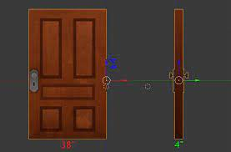
How would you get a door to open?
Notes:
Simple Animation:
Pre-animate the door's opening and closing in a software like Blender or Maya.
Trigger the animation in the game when necessary.
Pros: Easy to implement; consistent visual.
Cons: Fixed animation, no real-time dynamic interactions.
Physics-Based Interaction:
Use game engine physics to swing or slide the door open.
Can be influenced by player interactions or other game world entities.
Pros: Dynamic, can have real-time interactions (like stopping the door with an object).
Cons: Can lead to unexpected behaviors; might be computationally more expensive.
Scripted Movement:
Use code to interpolate the door's position or rotation over time.
Pros: Fine control over speed, direction, and trigger conditions.
Cons: Less dynamic than a physics-based approach.
Proximity Trigger:
Automatically open the door when the player or an entity approaches.
Pros: Simplifies interaction for the player.
Cons: Can be less immersive; unexpected openings if not fine-tuned.
Manual Interaction:
Require the player to press a button or perform an action to open the door.
Pros: More immersive; gives the player control.
Cons: Can be frustrating if interaction is not well-signaled.

Slide 4
01
Raycasts
Building interactivity

Slide 5
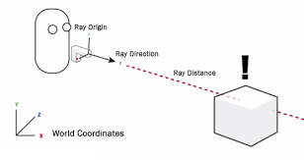
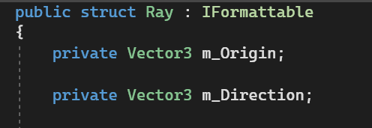
Raycasts (1)
These are lines or ‘Rays’ that are projected by Unity’s physics system.
A Ray has an origin point and a direction.

Slide 6
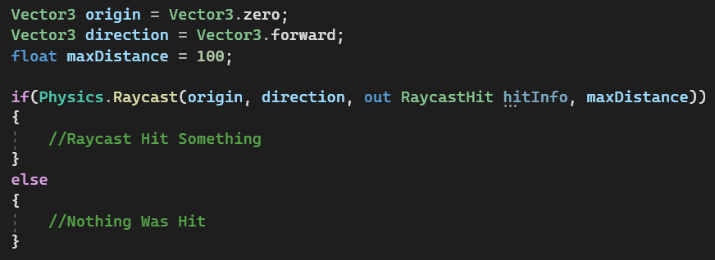
Raycasts (2)
There are different versions of the function:
Raycast() returns true/false.
We put it in an if statement so that we only check the data if something was hit.
‘Out’ keyword is used on one of the variables.
This indicates that the function will write info to that variable.
Notes:
Mention different versions of the

Slide 7
Raycasts (3)
The RaycastHit struct holds useful information about the hit object.
collider: The Collider that the ray hit.
distance: The Distance from the ray's origin to the hit point.
normal: The Normal of the surface that the ray hit. This is a vector that points directly out of the surface. Useful for determining the angle of impact or aligning objects with the hit surface.
point: The exact point in 3D space where the ray hit the collider.
rigidbody: The Rigidbody (if any) attached to the hit object. This will be null if the object doesn't have a Rigidbody component.
transform: The Transform of the hit object. Useful for directly manipulating the position, rotation, or scale of the hit object or for accessing other components.
Notes:
Mention different versions of the

Slide 8
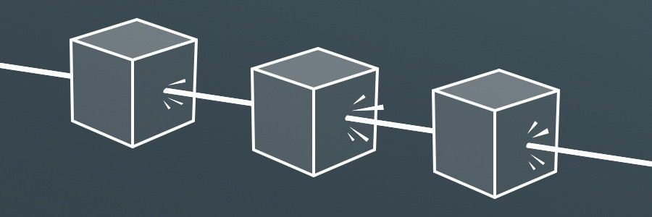
Raycasts (4)
The standard raycast stops at the first collision.but in some scenarios we may want to keep checking all the objects in a path.
For this we use RaycastAll. This will be more performance-intensive, especially if there are many objects to collide with. One way to reduce this is to limit the max distance
RaycastAll returns an array of hits as opposed to a boolean. The array will be empty if nothing was hit.
Notes:
Mention different versions of the

Slide 9
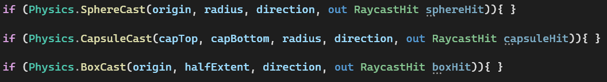
Raycasts (5)
You can also use shape casts which can be used to check areas for collisions. These also have a ‘All’ version.
Notes:
Mention different versions of the

Slide 10
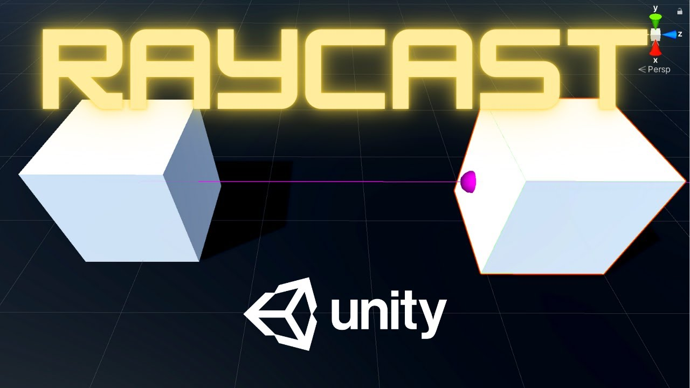
Raycasts (6)
Raycasts are invisible. You can use debug functions to visualise them and check for issues in your code.
Make sure you remove any Debug code from your final build.
Notes:
DEMO A OBJECT TARGETER.

Slide 11
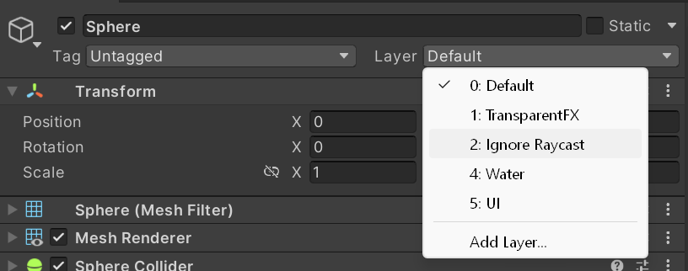
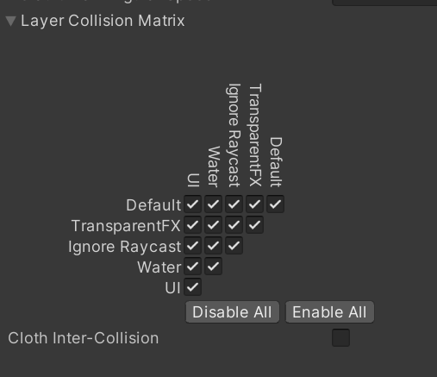

Raycasts (7)
Raycasts can get expensive very quickly. Here some things to consider.
Avoid FixedUpdate unless necessary (not always avoidable)
Use layer masks
Limit raycasts distances and ‘All’ versions
Check the collision matrix if you ray is only meant to hit one type of object.
Notes:
DEMO A OBJECT TARGETER.

Slide 12
02
Intro to Animation

Slide 13
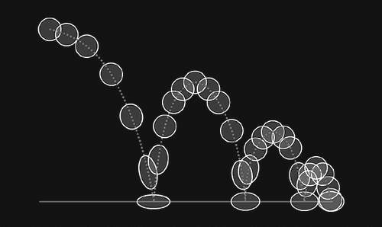
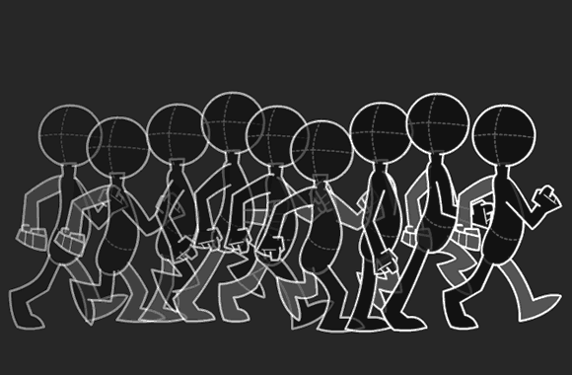
Introduction to Animation
Keyframes:
Keyframes are distinct frames within an animation timeline where specific attributes of an object or character are defined.
These attributes can include position, rotation, scale, color, and more.
Keyframes act as critical reference points that define how an object should appear or behave.

Slide 14
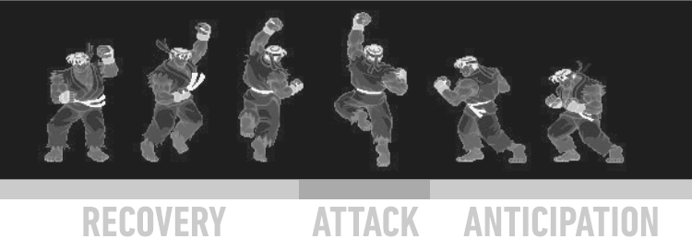
Animations(2)
Anticipation: The preparation phase before a key action, often involving a motion in the opposite direction to build tension and realism.
Attack: The main action or event, showcasing the intended movement or impact.
Recovery: The phase following the attack, involving a motion that counteracts the attack to add balance and realism, completing the movement cycle.

Slide 15
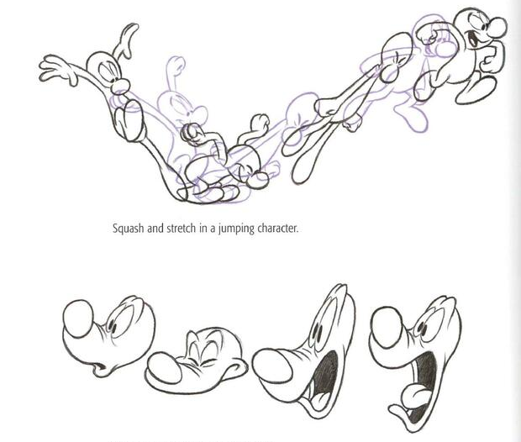
Animations (3)
Squash: The compression of an object or character to convey weight or impact, making it appear shorter and wider.
Stretch: The elongation of an object or character to emphasize speed or tension, making it appear taller and narrower.
Application of “squash and stretch” are used in animation to make character look more alive and fluid.

Slide 16
Animations (4)
Overshooting: The deliberate over exaggeration of an object or character's movement, often beyond its final resting point, to create a sense of elasticity, impact, or emphasis in animation. It adds energy and visual interest to movements by making them appear more dynamic and lively.

Slide 17
Animations (5)
Interpolation: In-between frames, also known as "tween frames," are generated automatically by the computer between two adjacent keyframes. Interpolation calculates the changes in attributes (e.g., position) between keyframes, creating a smooth transition from one state to another.
Easing: Keyframe animation often includes easing functions or curves that determine the rate of change between keyframes. Easing functions control the acceleration and deceleration of an object's motion, making animations more natural and visually appealing. Common easing types include linear, ease-in, ease-out, and ease-in-out.
Control and Timing: The placement and timing of keyframes are essential for controlling the animation's pace and behavior. You can adjust the timing by changing the distance between keyframes.

Slide 18
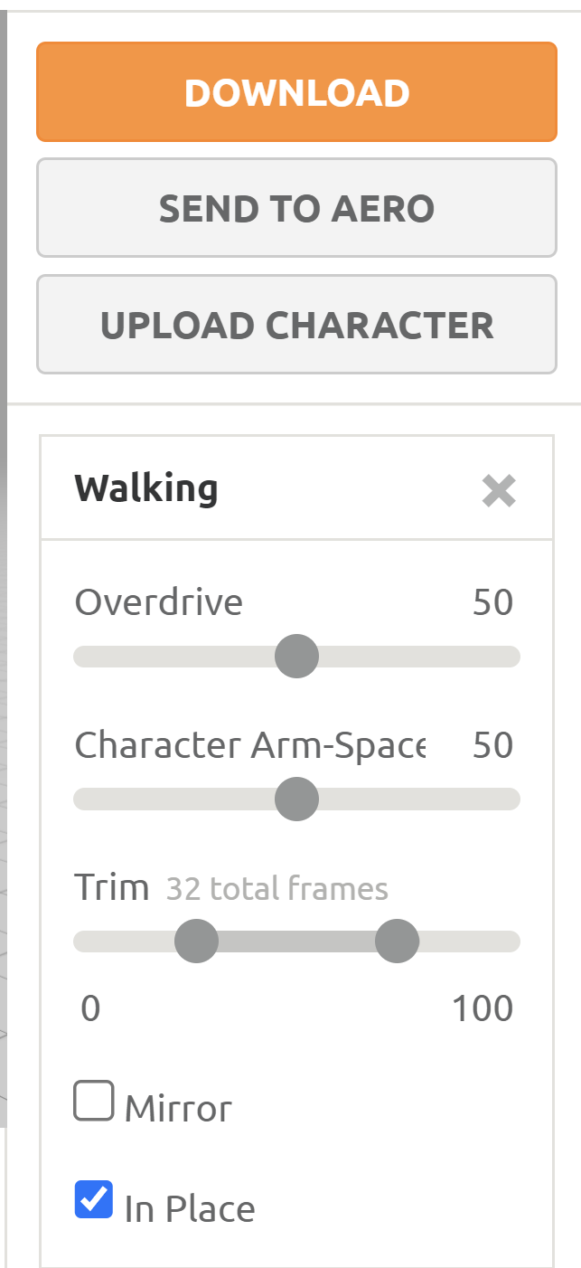
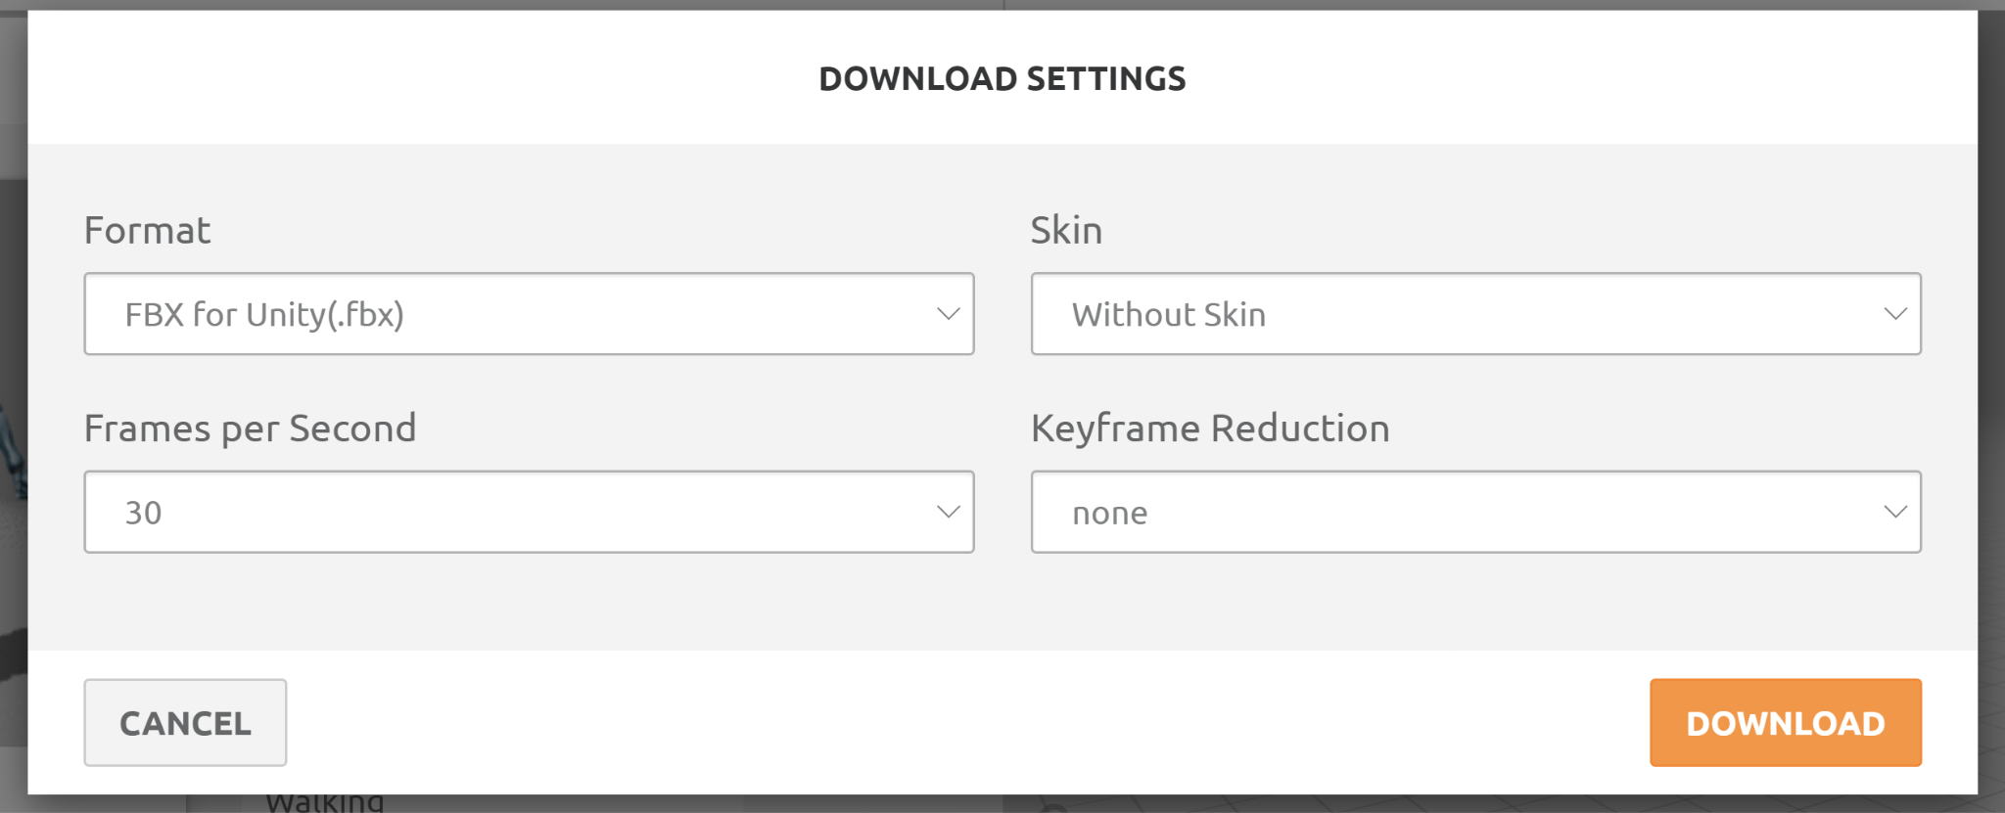

Slide 19
Thanks!

